Slide 1
Cross Sell Prediction
Team 1
Fatima Yousuf, Sushma Yammanuru,Venkata Anjali, Dheeraj Reddy, Srinath Reddy, Nishita Santhakumar

Slide 2

Agenda
Problem Statement
Literature
Data Description
Questions to be explored
Exploratory Data Analysis
Data Transformation
Models
Model comparison and evaluation
Recommendations

Slide 3
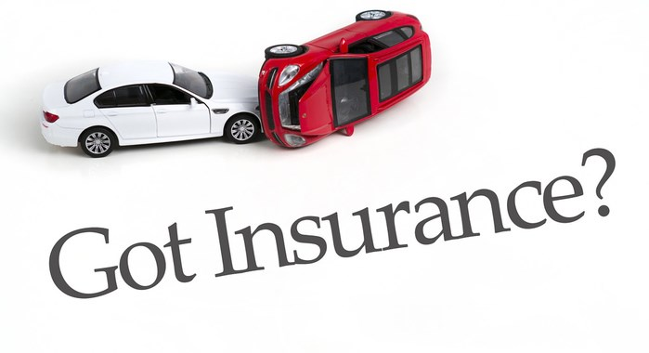
Problem statement
Health insurance
Vehicle insurance
Model Build
A Health insurance company with good number of customers wishes to grow in their vehicle insurance segment as well.
They are looking for a best prediction model to predict whether the customers from past will also be interested in vehicle Insurance provided by the company. This will help them design effective cross-selling strategies using health insurance customer data that can improve profitability and increase customer retention at the lowest cost of customer acquisition.
To expand their vehicle insurance business, they want to utilize their current health insurance customer base and promote vehicle insurance to generate additional revenue.

Slide 4

Literature
Prior Research
Our Project
Prior research has been conducted using different techniques and models such as SVM, XG Boost, KNN and there have been several competitions related to the Health Insurance Cross Sell Prediction task, some of which have been published on Kaggle.
The Accuracy score obtained for all models was in the range of 60% to 90%.
Oversampling using SMOTE as there was inherent class imbalance.
‘Policy_Sales_channel’ has been binned and converted into categorical variable for the prediction instead of default numerical data type.
GridSearchCV approach on models for hyperparameter tuning.

Slide 5
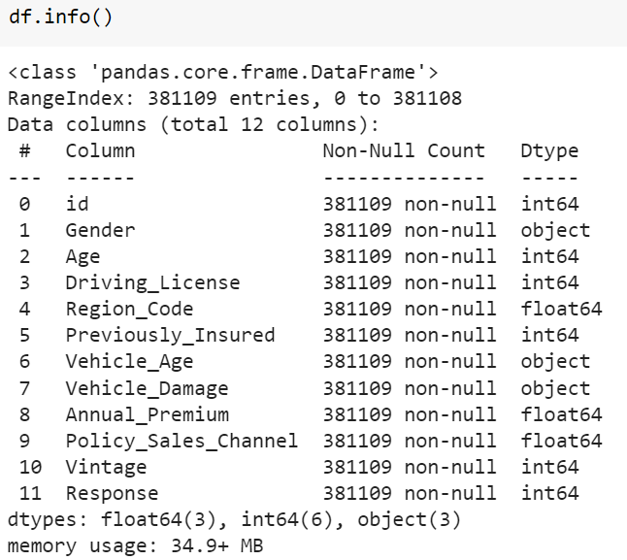
Data Description
381109 Rows & 12 columns
Target variable: Response (1 or 0)
Information about Demographics, Vehicles and Policy
No Null Values observed

Slide 6
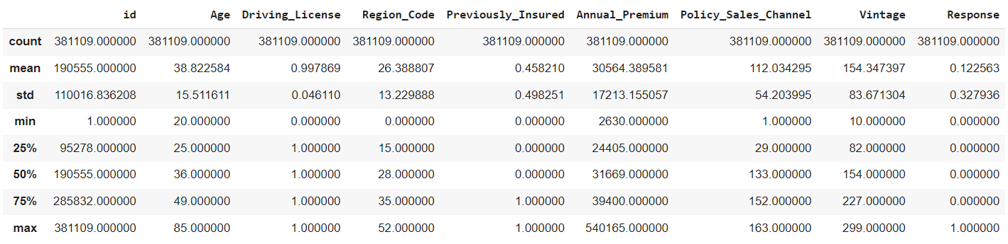
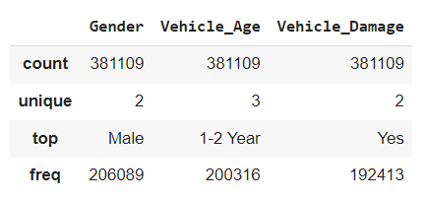
Data Description

Slide 7
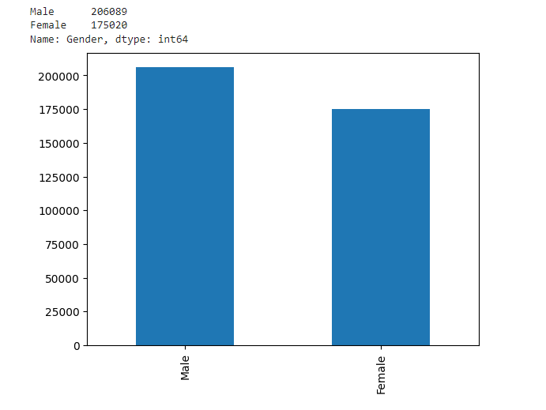
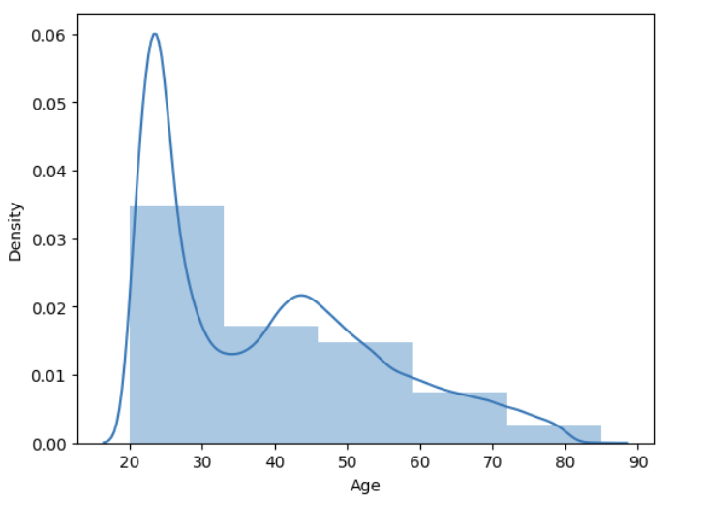
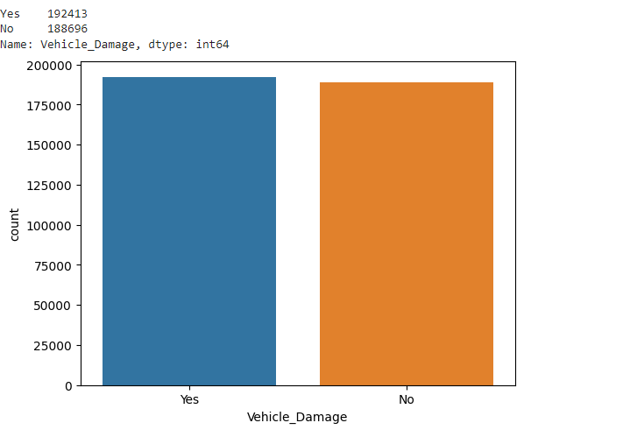
Exploratory Data Analysis
Gender
Customer age
Vehicle damage

Slide 8
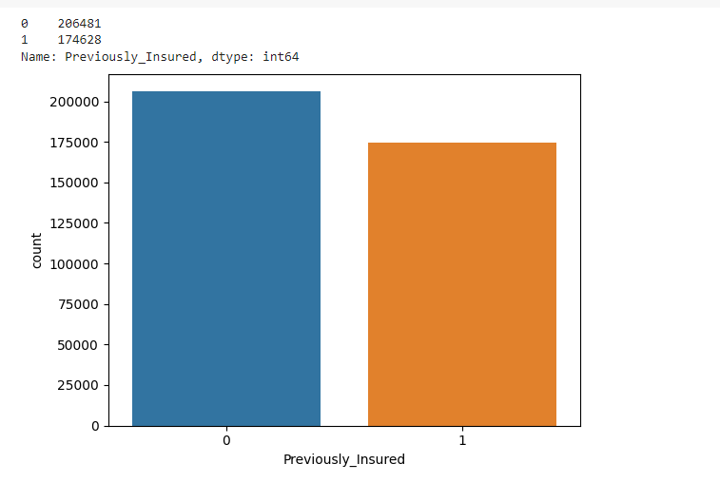
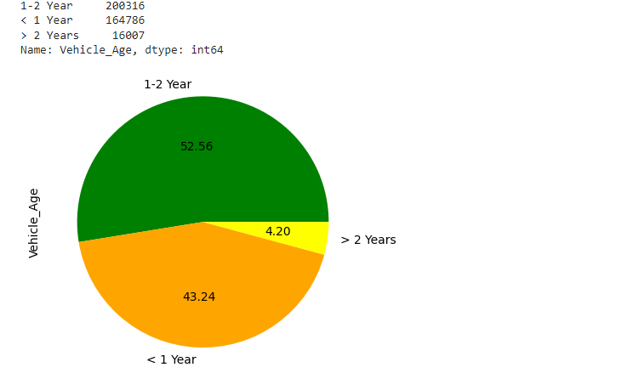
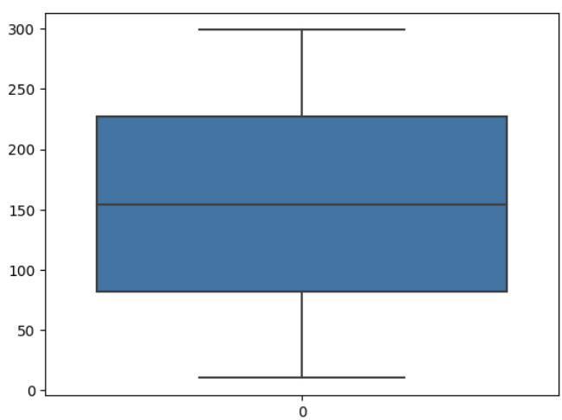
Exploratory Data Analysis
Previously insured
Driving age
Vintage

Slide 9
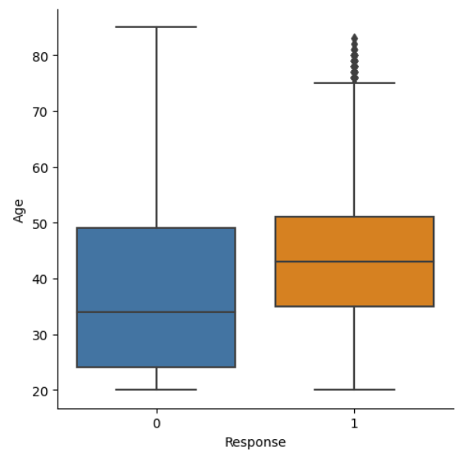
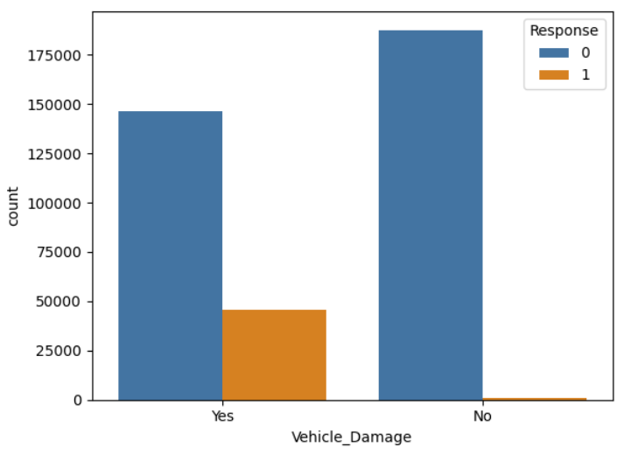
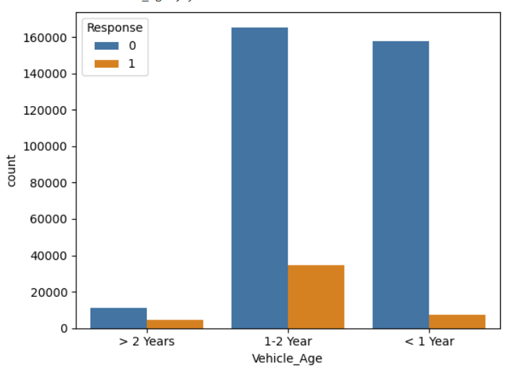
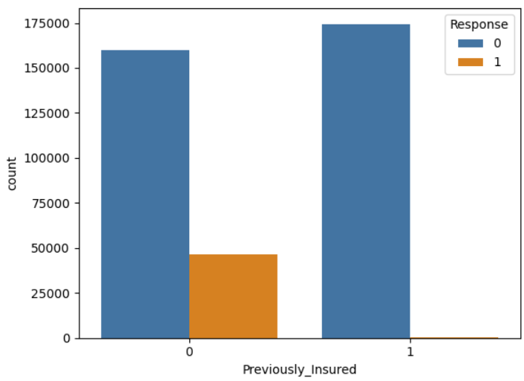
Exploratory Data Analysis

Slide 10
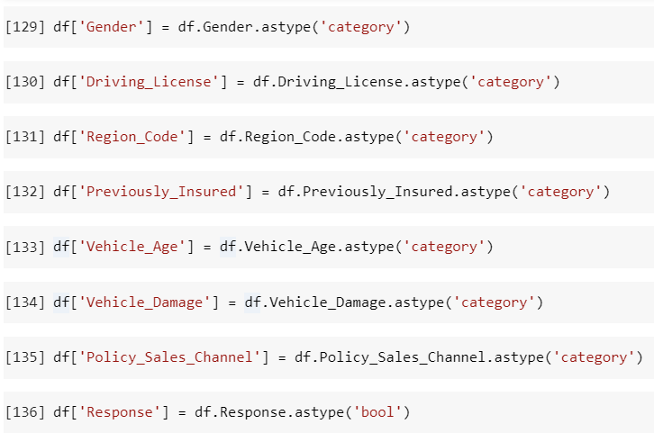
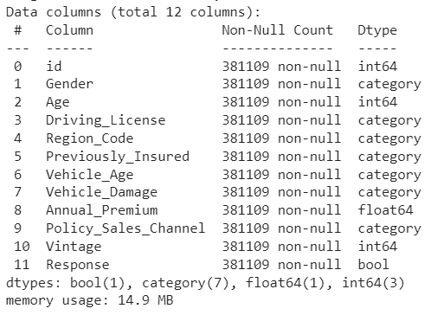
Data Transformation

Slide 11
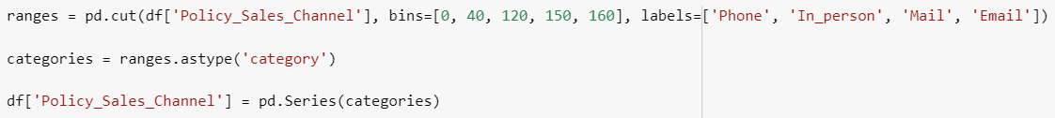
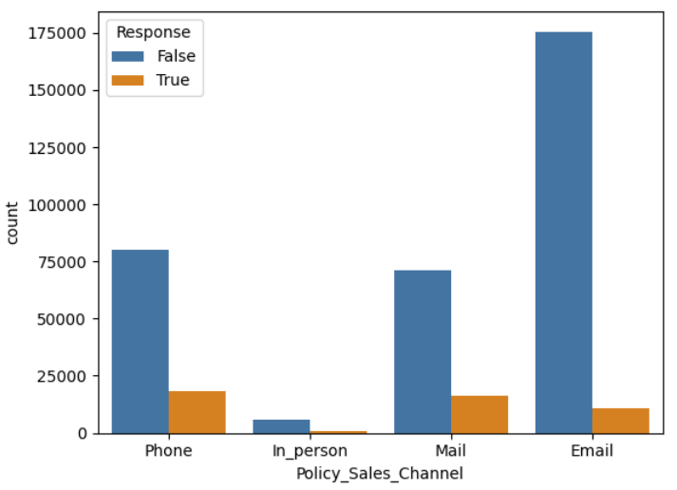
Data Transformation

Slide 12
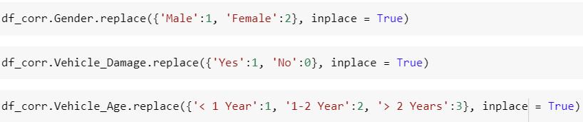
Data Transformation
Label Encoding:

Slide 13
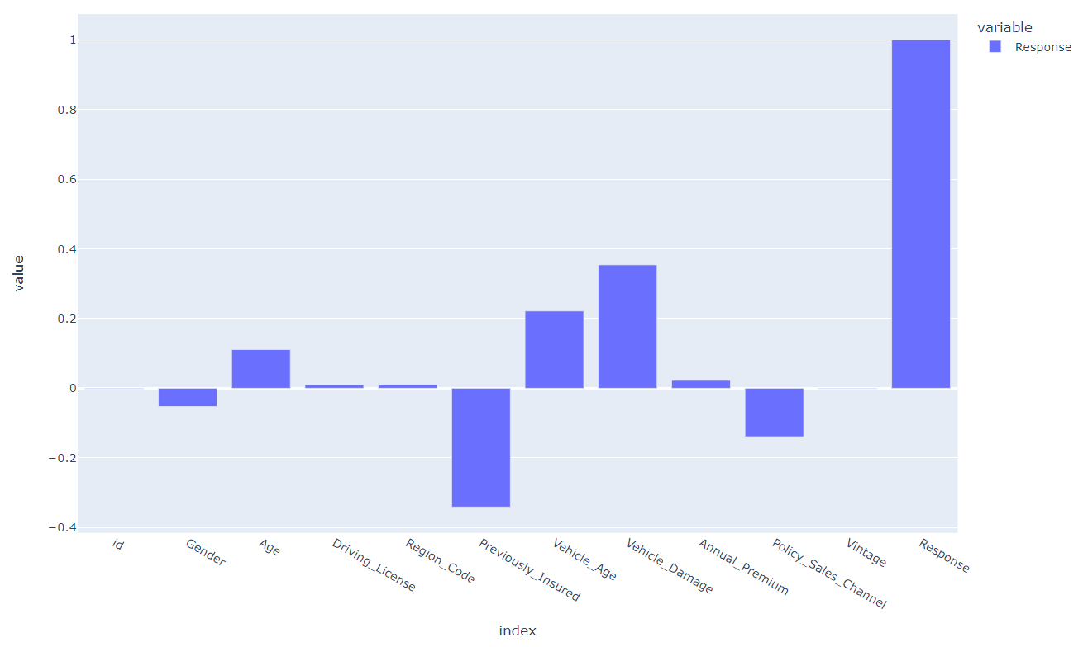
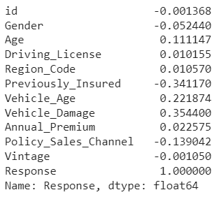
Correlation between variables

Slide 14
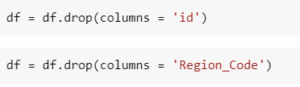
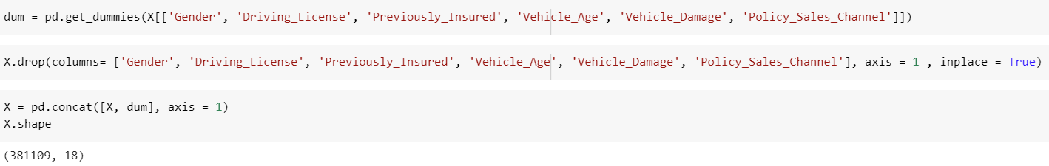
Data Transformation
Dropped columns:
Get dummies:

Slide 15
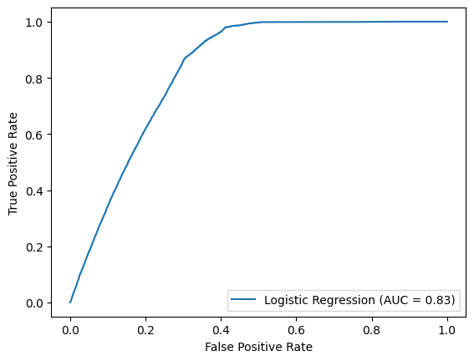
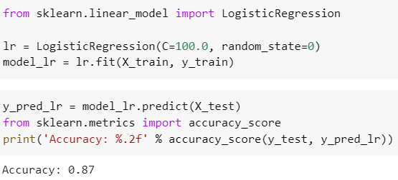
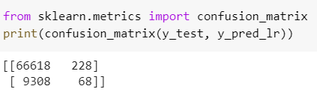
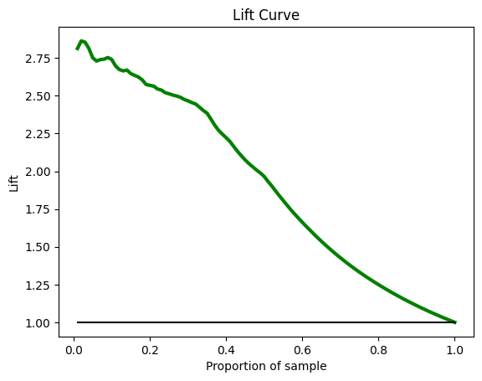
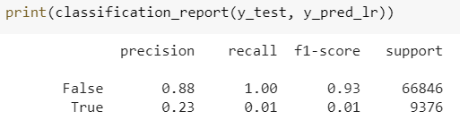
Logistic Regression with random sampling

Slide 16
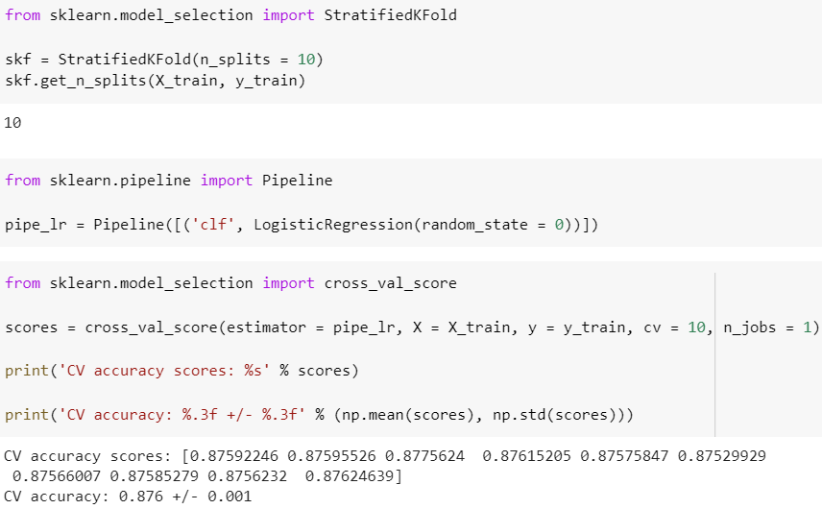
Pipelines and K fold cross validation

Slide 17
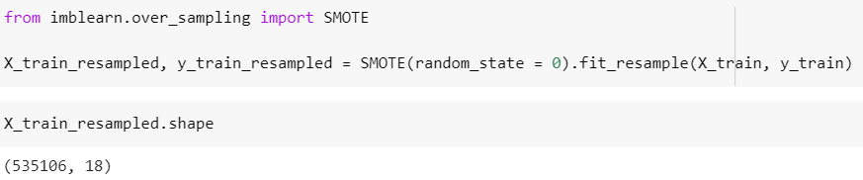
SMOTE oversampling
As there is a bias within the dataset towards response(high number of ‘0’), we have carried out SMOTE oversampling and increased the size of the X_train data set

Slide 18
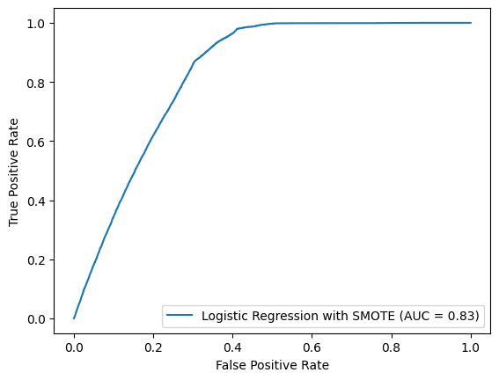
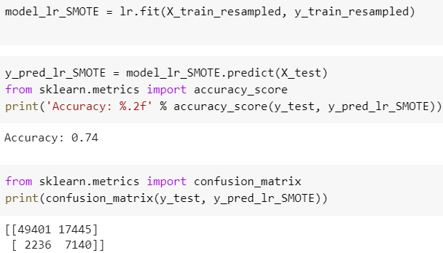

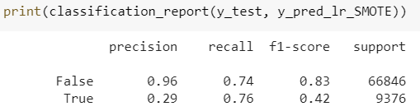
Logistic Regression with SMOTE

Slide 19
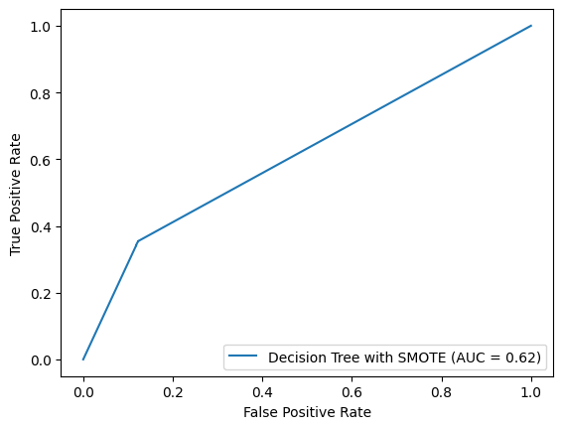
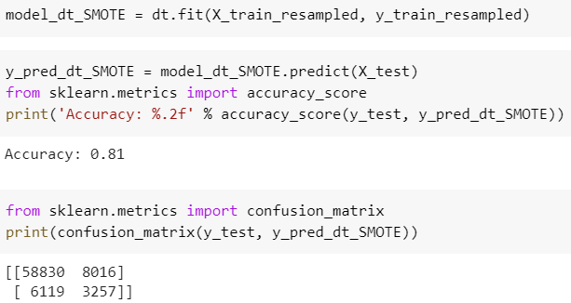
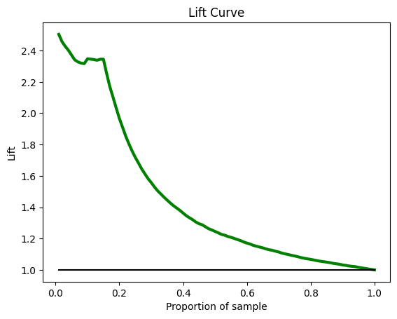
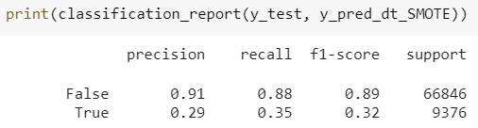
Decision Tree with SMOTE

Slide 20
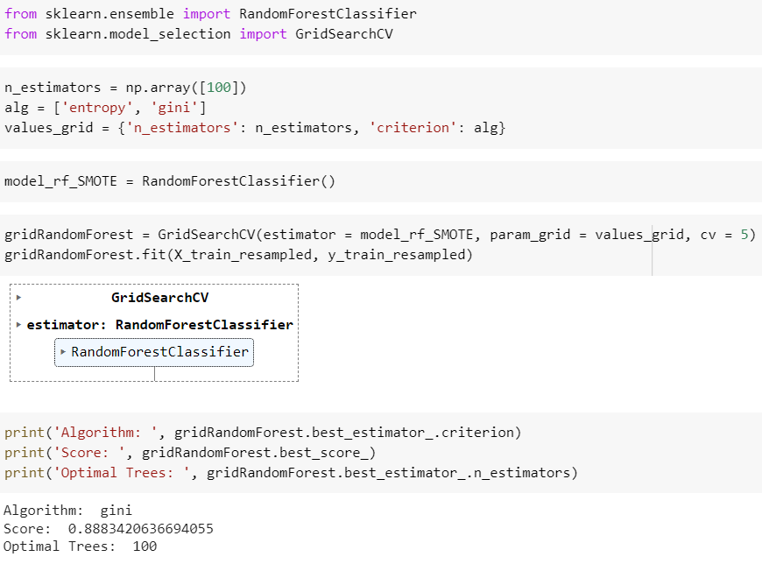
Random Forest - SMOTE & Grid Search

Slide 21
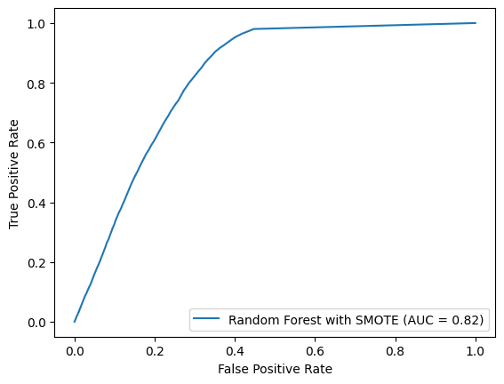
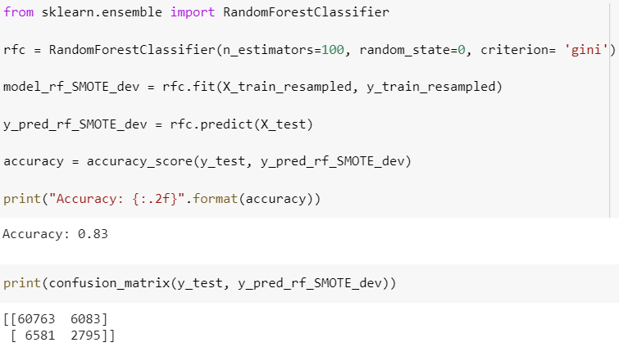
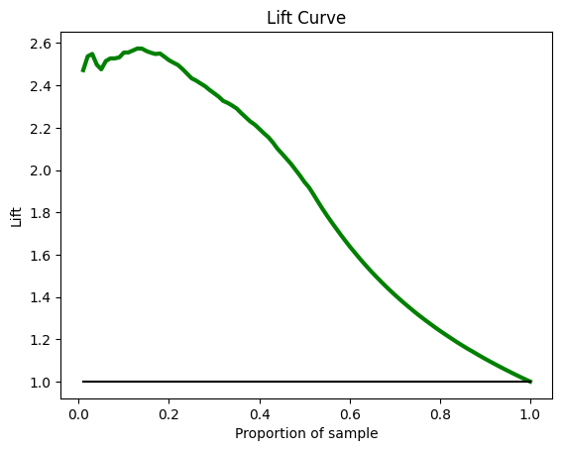
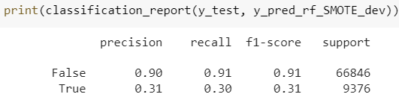
Random Forest - SMOTE & Grid Search

Slide 22
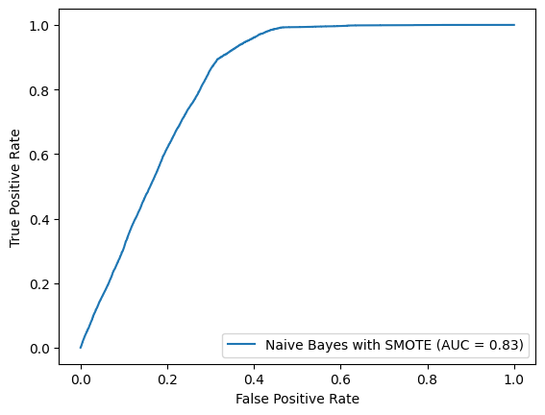
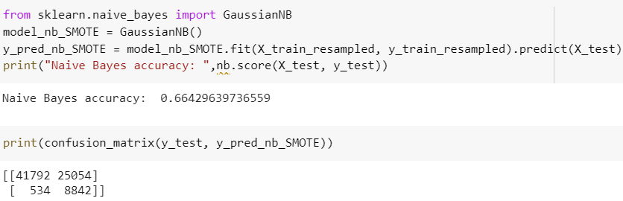
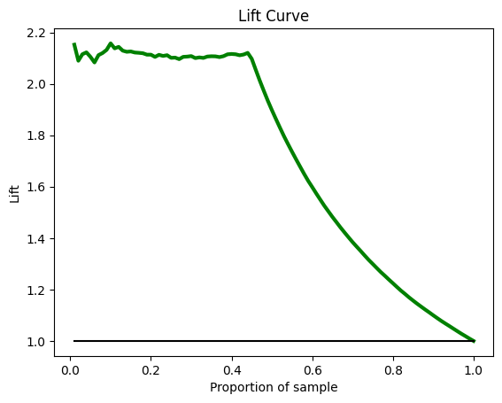
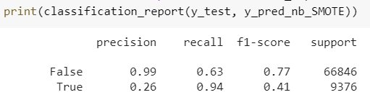
Naive Bayes with SMOTE

Slide 23
Model Comparison and Evaluation
Best Model is Logistic Regression
Models/Metrics | Accuracy | AUC | Precision | Recall | Lift
Logistic regression | 0.74 | 0.83 | 0.29 | 0.76 | 2.38
Decision Tree | 0.81 | 0.65 | 0.29 | 0.35 | 2.38
Random Forest | 0.83 | 0.82 | 0.31 | 0.30 | 2.54
Naive Bayes | 0.66 | 0.83 | 0.26 | 0.94 | 2.13

Slide 24

Profit-Loss Analysis
For Logistic Regression
For Naive Bayes
 | Predicted Negative | Predicted Positive
Actual Negative | 49401 | 17445
Actual Positive | 2236 | 7140
 | Predicted Negative | Predicted Positive
Actual Negative | 41792 | 25054
Actual Positive | 534 | 8842

Slide 25
Findings and Recommendations
Target Groups: The following customers are more likely to buy vehicle insurance:
Customers with age more than 35 years and below 50 years
Customers who currently do not have an insurance
Customers whose vehicle age is between 1 to 2 years
Customers whose vehicles already have damage
Pricing Strategy Optimization: Adjust pricing for vehicle insurance to target customers below the age of 35 to make it more attractive to them as they are high in number but have low probability of buying vehicle insurance. You can also consider pricing your policies in a way that offers lower premiums to customers whose vehicles have damages or no insurance, as they are more likely to purchase vehicle insurance.

Slide 26
Findings and Recommendations
Enhanced Marketing Strategy: Focus the marketing efforts on channels that have shown to be successful, such as phone and mail. Consider sending targeted marketing materials to customers whose vehicles have damages or do not currently have insurance. Use messaging that emphasizes the benefits of purchasing vehicle insurance, such as protection and peace of mind.
Personalized Offers: Create personalized offers for customers based on their age, vehicle age and vehicle damage. Younger customers(< 35 years) may respond well to lower premiums or discounts, while customers who have had accidents in the past may be more likely to respond to offers of additional coverage

Slide 27
References
Source: https://www.kaggle.com/datasets/anmolkumar/health-insurance-cross-sell-prediction
Chat GPT
https://scikit-learn.org/stable/

Slide 28


